Slide 1
MATHEMATICS FOR ELECTRONICS engineers UE21EC241A
Presented to: Dr. Rajini M

Slide 2
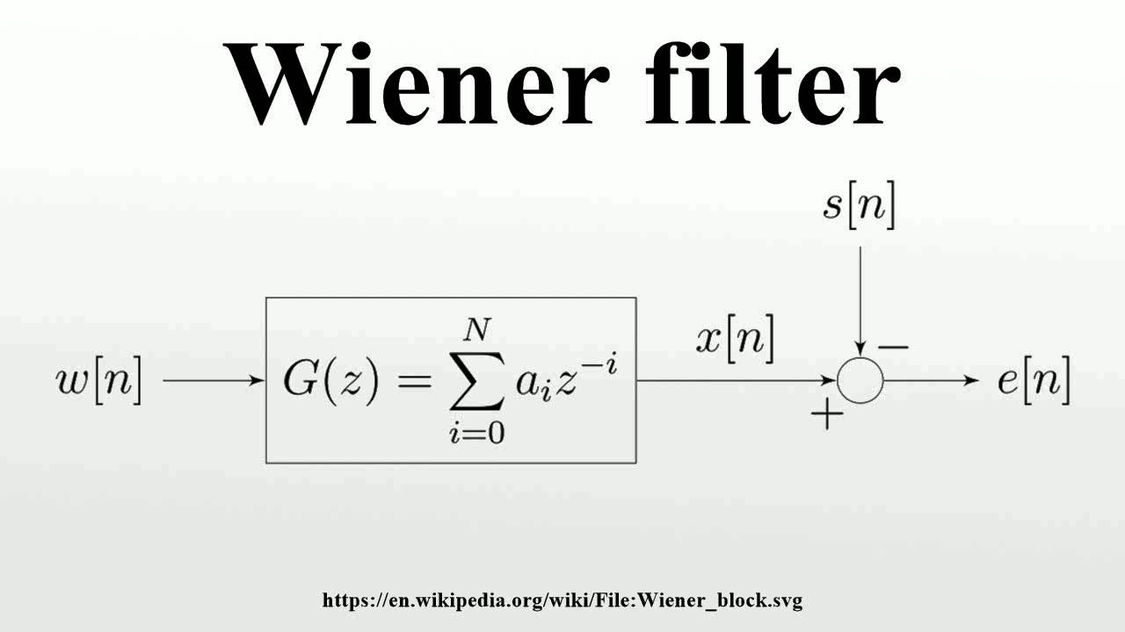
A PROBABLISTIC CASE STUDY ON Weiner filter
Members –
Achyuth S.S PES1UG21EC010
DHYAN KOUSHIK PES1UG21EC092
ANUSHKA PES1UG21EC054

Slide 3
contents
Introduction
Problem Statement
Mathematical methods used
Implementation (MATLAB)
Results
REFERENCES
Applications

Slide 4
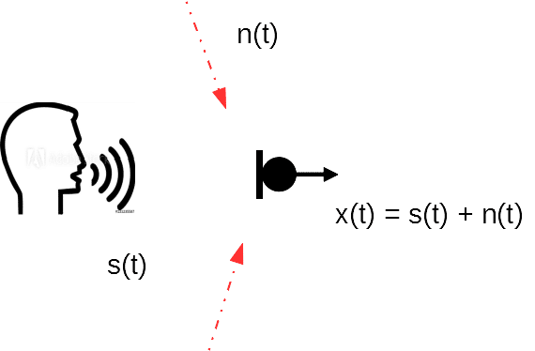

introduction
So, what is a Weiner Filter ?
In signal processing, Weiner Filter is a filter, used to produce a statistical estimate of a desired random process, by LTI filtering of an observed Noisy process, known as Stationary Signal and Noise Spectra.
Weiner Filters are characterized by : Assumption, Requirement & Performance Criteria.
It aims to achieve…..

Slide 5
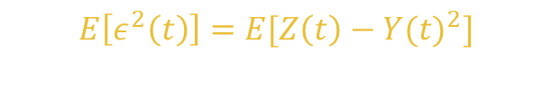


PROBLEM STATEMENT
Given a random process $X(t)$ , and we need to do a statistical estimate of $Y(t)$ of some zero-mean random process (without loss of generality) $Z(t)$ in order to estimate a part of $X(t)$, and thus we obtain $Y(t)$, by filtering out $X\left(t\right)$ as :
$$Y\left(t\right)=\int_{−∞}^{∞}{h\left(t−u\right)X\left(u\right)du}$$
To minimize the mean square error
$$E\left[ε^{2}\left(t\right)\right]=E[Z\left(t\right)−Y({t)}^{2}]$$
Let S(t + $α$) be an unknown signal, which must be estimated, from a measurement signal x(t), where α is called the tunable parameter.
x(t) for some time interval t $∈$ (t1,t2)

Slide 6
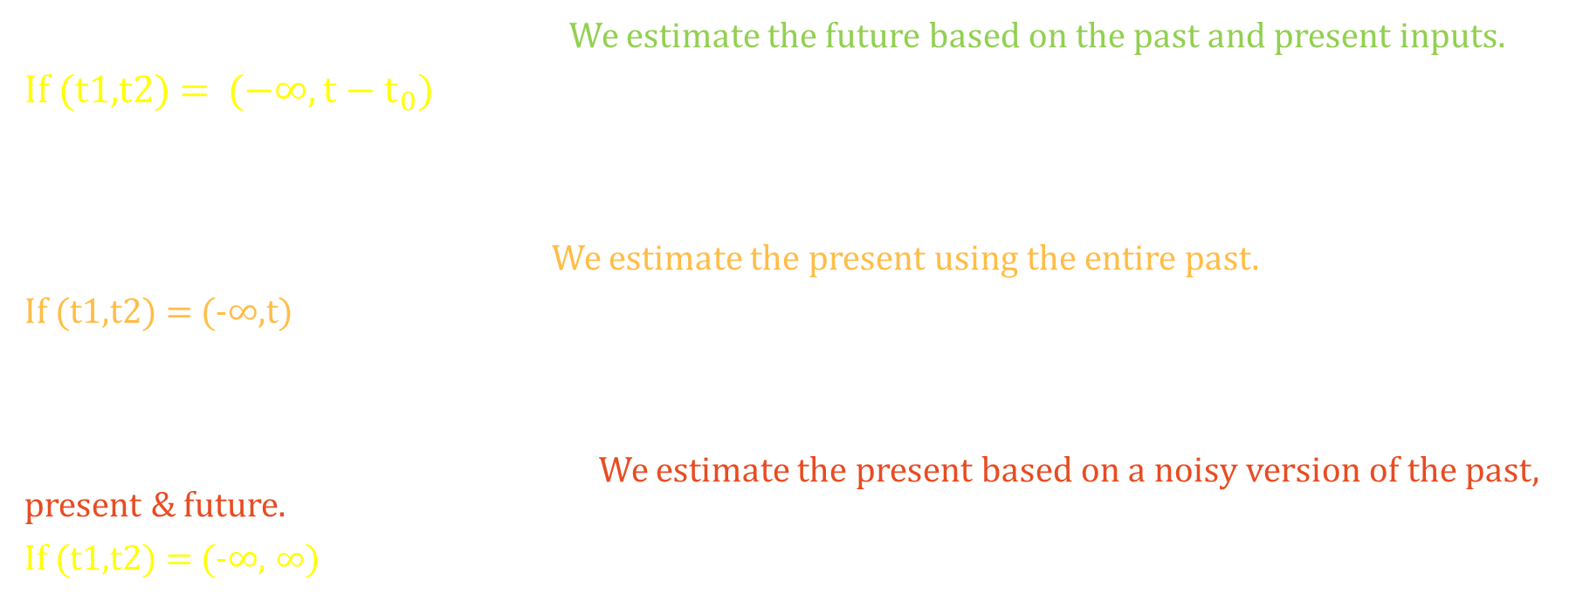
Case I : α > 0 – Prediction Problem We estimate the future based on the past and present inputs.
If (t1,t2) = $(−∞,t−t_{0})$
Case II : α = 0 – Filtering Problem We estimate the present using the entire past.
If (t1,t2) = (-$∞$,t)
Case III : α < 0 – Smoothing Problem We estimate the present based on a noisy version of the past, present & future.
If (t1,t2) = (-$∞$, $∞$)

Slide 7
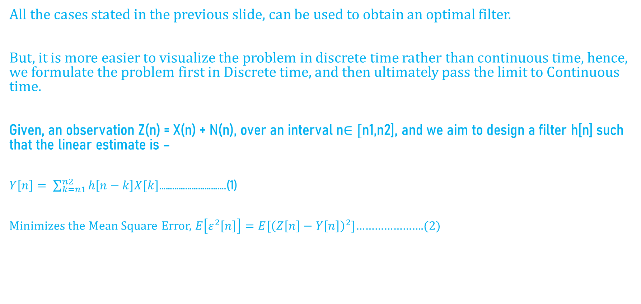
METHODOLOGY USED TO derive wiener filter
All the cases stated in the previous slide, can be used to obtain an optimal filter.
But, it is more easier to visualize the problem in discrete time rather than continuous time, hence, we formulate the problem first in Discrete time, and then ultimately pass the limit to Continuous time.
Given, an observation Z(n) = X(n) + N(n), over an interval n$∈[$n1,n2], and we aim to design a filter h[n] such that the linear estimate is –
$Y\left[n\right]= \sum_{k=n1}^{n2}{h\left[n−k\right]X[k]}$………………………….(1)
Minimizes the Mean Square Error, $E\left[ε^{2}\left[n\right]\right]=E[{\left(Z\left[n\right]−Y\left[n\right]\right)}^{2}]$………………….(2)

Slide 8

The Filter h[n] can be viewed as a sequence of variables, and since we need to optimize wrt each variable, it can be done by Differentiating with respect to each variable, and setting the resulting equation, equal to zero.
From eqn(2),
$\frac{d}{dh[m]}E\left[ε^{2}\left[n\right]\right]=2E\left[ε\left[n\right]\frac{d}{dh\left[m\right]}ε\left[n\right]\right]=0$, $mε\left[n−n_{2},n−n_{1}\right]$
And observing that,
$$\frac{d}{dh[m]}E\left[ε\left[n\right]\right]=\frac{d}{dh\left[m\right]}\left(Z\left[n\right]−Y\left[n\right]\right)=\frac{−d}{dh[m]}Y\left[n\right] =−X\left[n−m\right], that is Z\left[n\right]is the noise, hence the derivative vanishes$$
Thus, the system of equations, is
$E\left[ε\left[n\right]X\left[n−m\right]\right]=0, for m ε [n−n_{1},n−n_{2}]$

Slide 9
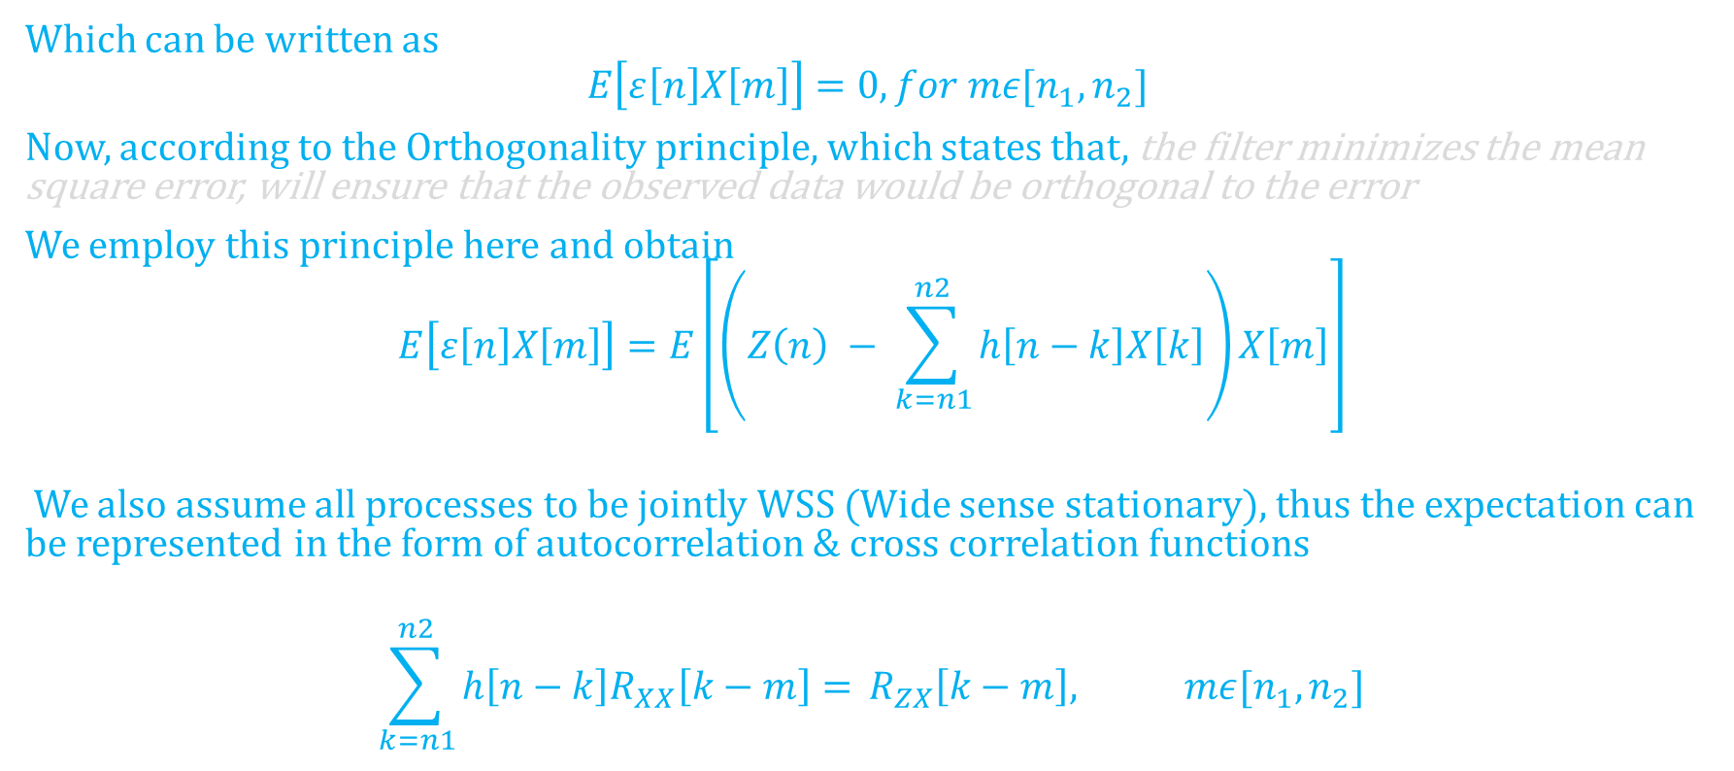
Which can be written as
$$E\left[ε\left[n\right]X\left[m\right]\right]=0, for mε[n_{1},n_{2}]$$
Now, according to the Orthogonality principle, which states that, the filter minimizes the mean square error, will ensure that the observed data would be orthogonal to the error
We employ this principle here and obtain
$$E\left[ε\left[n\right]X\left[m\right]\right]=E\left[\left(Z\left(n\right) − \sum_{k=n1}^{n2}{h\left[n−k\right]X\left[k\right]}\right)X\left[m\right]\right]$$
We also assume all processes to be jointly WSS (Wide sense stationary), thus the expectation can be represented in the form of autocorrelation & cross correlation functions
$$\sum_{k=n1}^{n2}{h\left[n−k\right]R_{XX}\left[k−m\right]= }R_{ZX}\left[k−m\right], mε[n_{1},n_{2}]$$

Slide 10
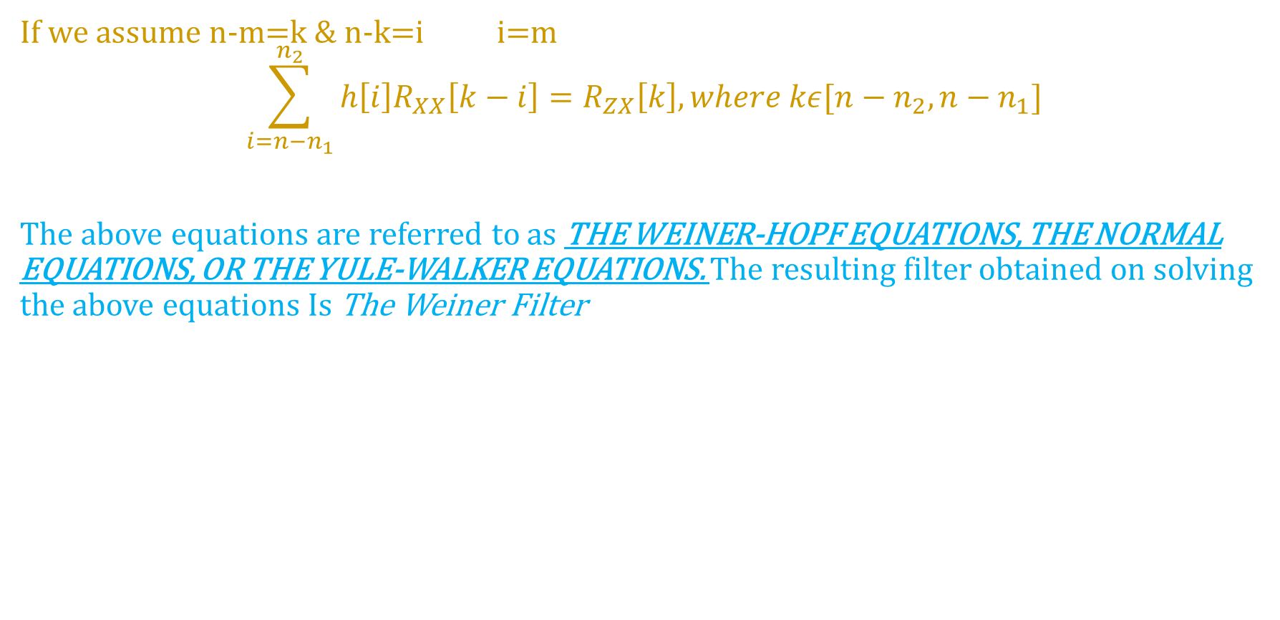
If we assume n-m=k & n-k=i i=m
$$\sum_{i=n−n_{1}}^{n_{2}}{h\left[i\right]R_{XX}\left[k−i\right]=R_{ZX}\left[k\right], where kε[n−n_{2},n−n_{1}]}$$
The above equations are referred to as THE WEINER-HOPF EQUATIONS, THE NORMAL EQUATIONS, OR THE YULE-WALKER EQUATIONS. The resulting filter obtained on solving the above equations Is The Weiner Filter

Slide 11
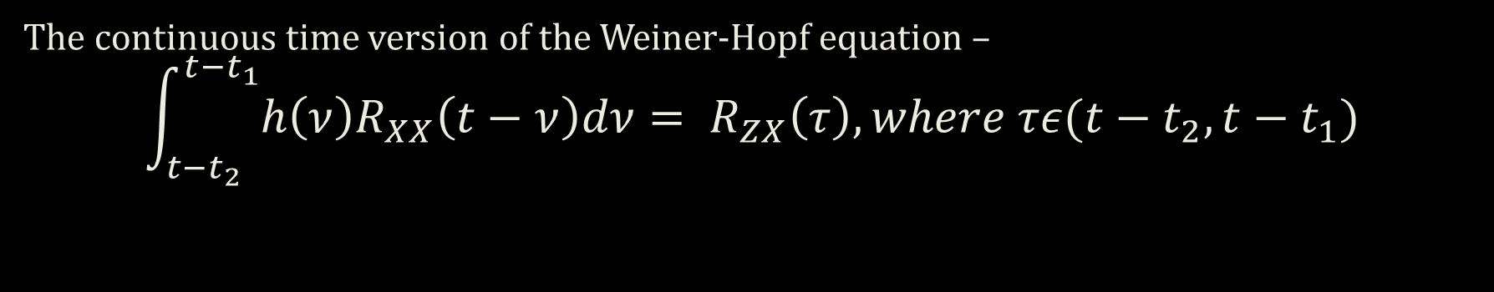
THE SAME EQUATIONS IN CONTINUOUS TIME
The continuous time version of the Weiner-Hopf equation –
$$\int_{t−t_{2}}^{t−t_{1}}{h\left(ν\right)R_{XX}\left(t−ν\right)dν= R_{ZX}\left(τ\right), where τε(t−t_{2},t−t_{1})}$$

Slide 12


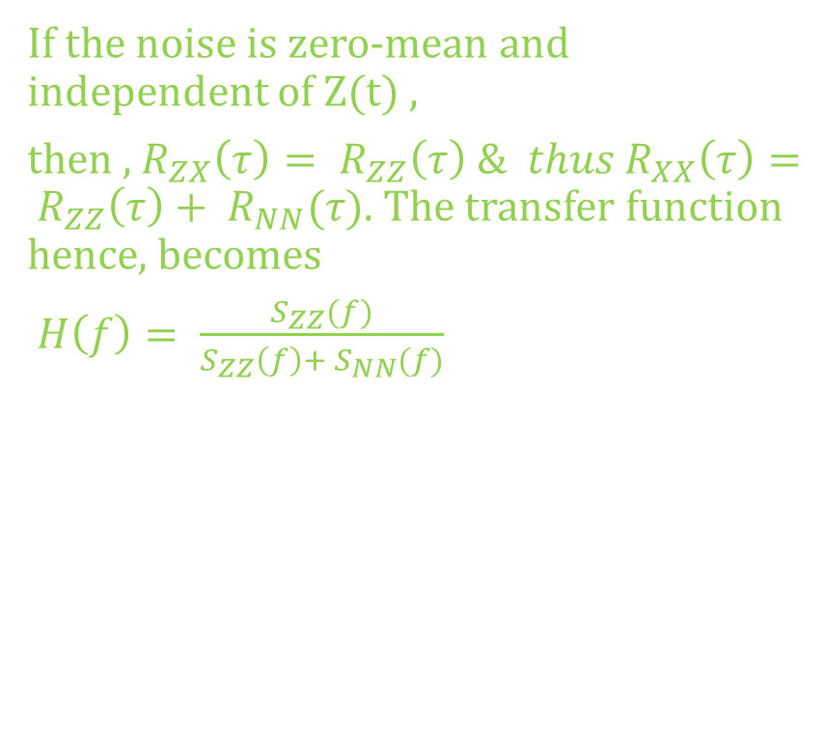
CASE – I THE SMOOTHING PROBLEM $$\left(t_{1},t_{2}\right)=(−∞,∞)$$
In this case, the Weiner-Hopf equations turns out as,
$\int_{−∞}^{∞}{h\left(ν\right)R_{XX}\left(τ−ν\right)dν= }$ $R_{ZX}(τ)$
We may see, that the Left side of the equation is a convolution, and can be easily evaluated by applying the Fourier Transform. Thus, we take a Fourier Transform on both sides, as
$$ℱ\left(\int_{−∞}^{∞}{h\left(ν\right)R_{XX}\left(τ−ν\right)dν}\right)= ℱ\left(R_{ZX}\left(τ\right)\right)$$
$$⇒H\left(f\right)S_{XX}\left(f\right)= S_{ZX}\left(f\right)=H\left(f\right)⇒ \frac{S_{ZX}(f)}{S_{XX}(f)}$$
If the noise is zero-mean and independent of Z(t) ,
then , $R_{ZX}\left(τ\right)= R_{ZZ}\left(τ\right) \& thus R_{XX}\left(τ\right)= R_{ZZ}\left(τ\right)+ R_{NN}(τ)$. The transfer function hence, becomes
$H\left(f\right)= \frac{S_{ZZ}(f)}{S_{ZZ}\left(f\right)+ S_{NN}(f)}$

Slide 13

CASE II – THE FILTERING Problem
When (t1,t2) = ($−∞,∞$), the Weiner-Hopf equation would become
$$\int_{0}^{∞}{h\left(ν\right)R_{XX}\left(τ−ν\right)= R_{ZX}\left(τ\right), where τε(0, ∞)}$$
Since, it is clear, there is non-existence of any convolution, we develop a procedure to solve the general equation. Here, we take $R_{XX}\left(τ\right)= δ\left(t\right), in which case, the equation becomes$
$h\left(τ\right)= R_{ZX}\left(τ\right), for τ>0$

Slide 14
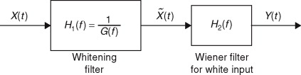


We design the Weiner Filter using two stages-
We use the result arrived of the previous special case, to get Z(t), based on white process $\tilde{X}\left(t\right).$ 1. To find the impulse response of the second filter, we start with $$h^{2}\left(τ\right)= R_{Z\tilde{X}}\left(τ\right)U\left(τ\right), and since\tilde{X}\left(t\right) is also X\left(t\right)∗h_{1}\left(t\right), thus S_{Z\tilde{X}}\left(f\right)= S_{ZX}\left(f\right)H_{1}^{∗}(f).$$
The resulting quantities for constructing the second filter are
$$R_{Z\tilde{X}}\left(f\right)= ℱ^{−1}\left(\frac{S_{ZX}\left(f\right)}{G^{∗}\left(f\right)}\right)$$
And to we need to find a G(f) such that 1/ G(f) = H1(f)
And |G(f)|² = $S_{XX}\left(f\right)$ And Since $S_{XX}\left(f\right)$ is a PSD and an even function of f, it will factor as
$$S_{XX}\left(f\right)=G(f)G^{∗}(f)$$
Thus, half of the poles & zeroes are assigned to G(f), and other half to G*(f), and in the upper half-plane.
Since, the system must be causal,
The Weiner Filter Is $h\left(τ\right)= R_{ZX}\left(τ\right)u(τ)$
Since, we do not want X(t) to be white,
We use the Spectral Factorization, with Whitening filter approach to solve further,
H1(f) is the transfer function of the Whitening filter, whose output we assume as $\tilde{X}\left(t\right).$

Slide 15

CASE III – THE PREDICTION PROBLEM
I$f \left(t1,t2\right)=\left(−∞,t{−t}_{o}\right). Apply the orthogonality principle, and the problem to solve is$ $$\int_{0}^{∞}{h\left(ν\right)R_{XX}\left(τ−ν\right)dν= R_{ZX}\left(τ\right), τε(0,∞)}$$
Using the same technique as applied in the Filtering problem, we obtain $$h\left(τ\right)= R_{ZX}\left(τ\right)u(τ−t_{o})$$

Slide 16
IMPLEMENTATION {MATLAB}
Create the function to find the Weiner-Filter-
function [xest,B,MSE] = WeinerFilt(x,y,N)
X = 1/N .* fft(x(1:N));
Y = 1/N .* fft(y(1:N));
X = X(:);
Y = Y(:);
Rxx = N .* real(ifft(X .* conj(X))); % Autocorrelation function
Rxy = N .* real(ifft(X .* conj(Y))); % Crosscorrelation function
Rxx = toeplitz(Rxx);
Rxy = Rxy';
B = Rxy / Rxx; B = B(:); % Wiener-Hopf eq. B = inv(Rxx) Rxy
xest = fftfilt(B,x);
xest = xest(N+1:end); % cut first N samples due to distorsion during filtering operation
MSE = mean(y(N+1:end) - xest) .^2; % mean squared error

Slide 17
%Demonstrating Weiner Filter using Weiner-Hopf equations
% Code to remove a noisy portion of a corrupted signal, back to the
% reference signal
clear
close all
clc
fs = 6325; %frequency of samples
T = 3; %total recording tme
L = T.*fs; %length of vector
tt = (0:L-1)/fs; %time vector
ff = (0:L-1).*fs / L;
y = 3*sin(2*pi*90.*tt); y = y(:); %sinusoidal reference signal
x = 0.70*randn(L,1) + y; x = x(:); % reference signal with noise added
N = 500;
[xest, b, MSE] = WeinerFilt(x,y,N);
% we then plots the results as below
figure
subplot(311);
plot(tt,x,'k'), hold on, plot (tt,y,'r');
title('Weiner Filter Demo');
legend('Noisy signal', 'reference Signal');
subplot(312);
plot(tt(N+1:end), xest, 'k');
legend('Estimated signal');
subplot(313);
plot(tt(N+1:end), (x(N+1:end) - xest), 'k');
legend('Residue signal after removal of noise');
xlabel('time (s)')

Slide 18
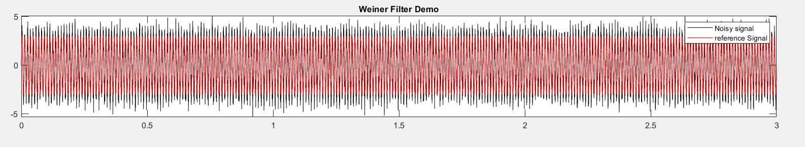
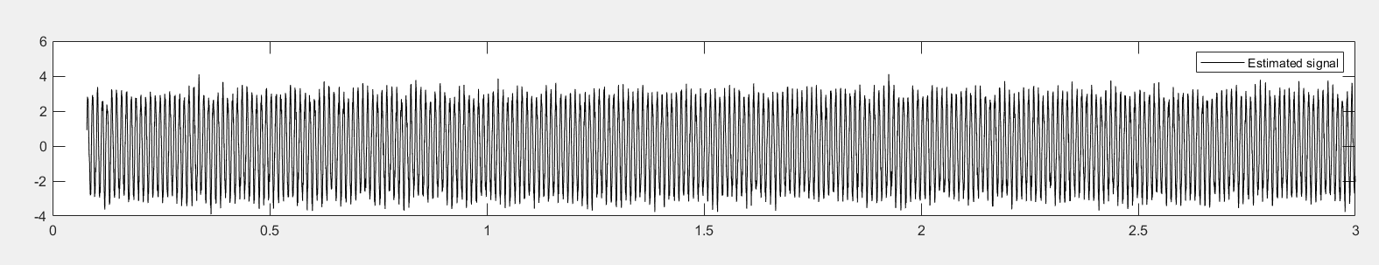
RESULTS
The reference signal along with the noise -
The estimated noise -

Slide 19
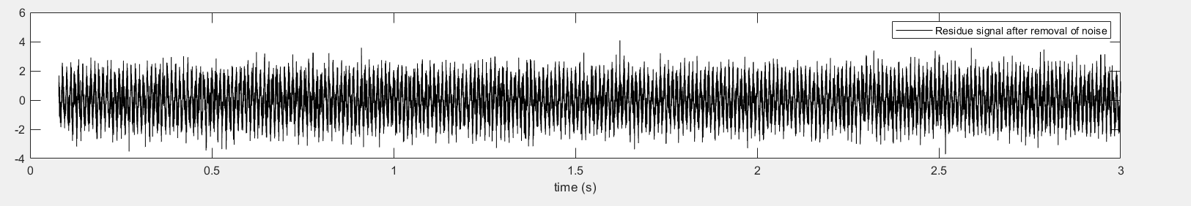
Thus, the residue signal is –

Slide 20
references
MATLAB
Github

Slide 21
APPLICATIONS
Wiener filters play a central role in a wide range of applications such as linear prediction, echo cancellation, signal restoration, channel equalisation and system identification. This is a fairly expensive filter, in terms of computational cost and time, it is applied on every pixel of the image
Application of Wiener and Adaptive Filters to GPS and Glonass Data from the Rapid Prototyping Array
Weiner Filters play a crucial role in Echo cancellation, linear prediction, signal restoration etc.

Slide 22
THANK YOU

